Slide 1
Extreme Learning Machine
2/23/17
CS698 Current Topics in Data Science- Abdulrhman Aljouie Extreme Learning Machine

Slide 2
Outline
Extreme Learning Machine Motivation.
Structure of Extreme Learning Machine (ELM).
Basis of Extreme Learning Machine.
Show an Example of training small data using ELM algorithm.
Show an Example of predicting small data using ELM algorithm.

Slide 3
Motivation
Feedforward Neural Nets such as back-propagation are slow and the reason is:
  Training using gradient based learning algorithms e.g. many iterative steps required to achieve better performance.
  The weights are adjusted iteratively using gradient methods.
Extreme Learning Machine (ELM) was proposed to overcome these issues and offer better generalization performance.

Slide 4
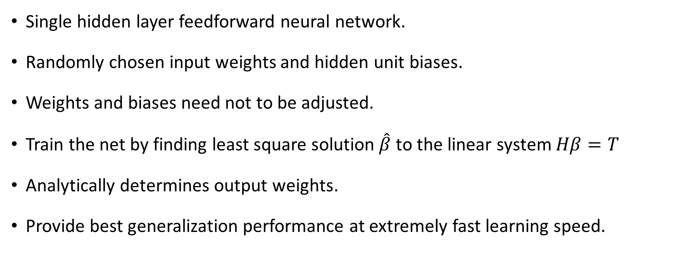
Extreme Learning Machine (ELM)

Slide 5
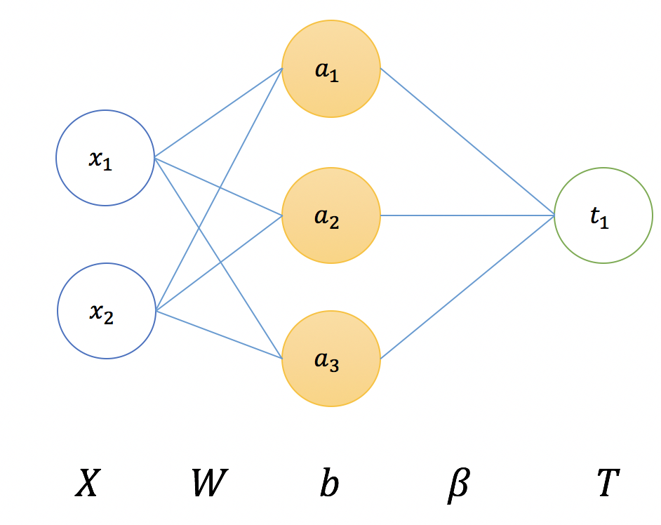
Structure of Extreme Learning Machine

Slide 6
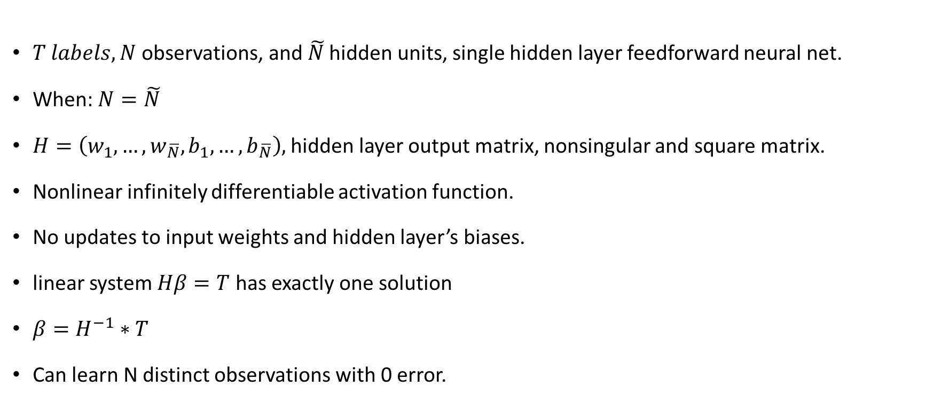
Initial idea

Slide 7
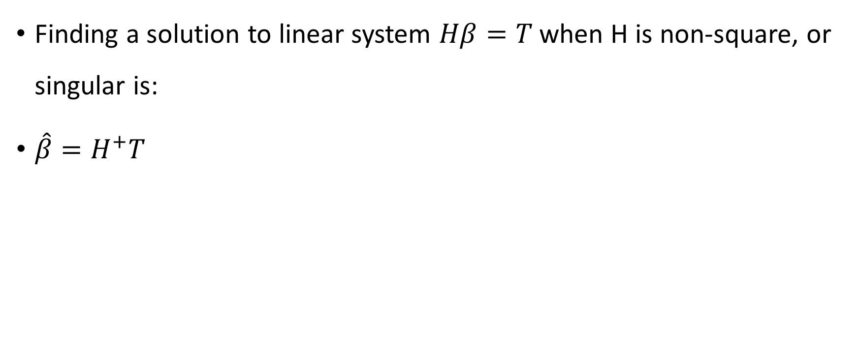
H is non-square or singular

Slide 8
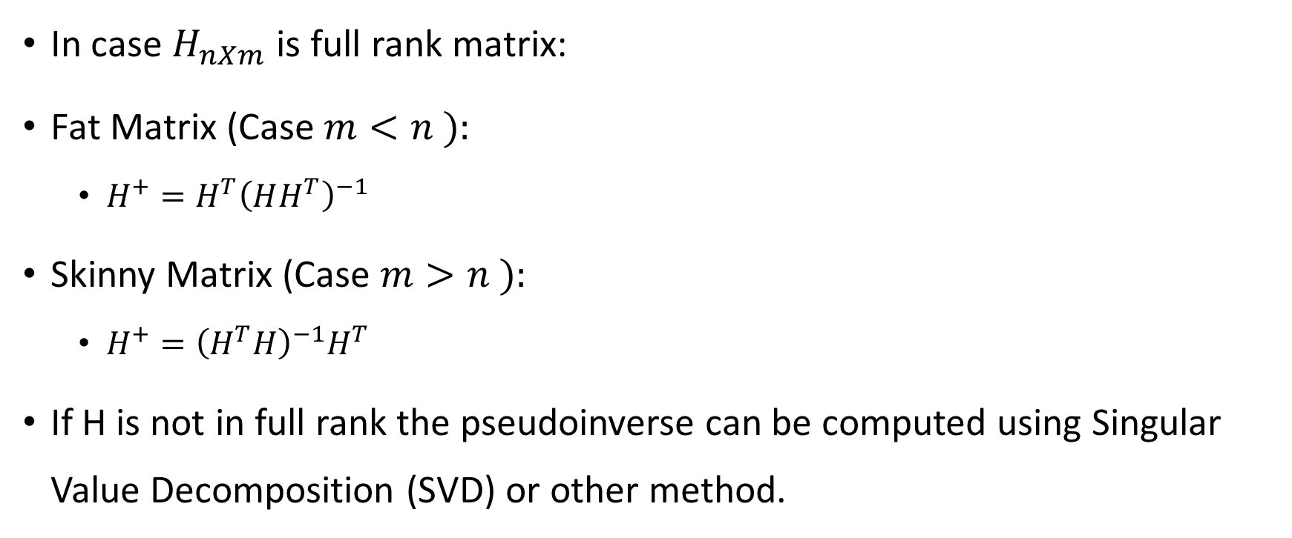
To calculate the pseudo inverse

Slide 9
To calculate the pseudo inverse
The Computation of Moore-Penrose Pseudo inverse through SVD (Singular Value Decomposition) is discussed in Class.
Please refer class note

Slide 10
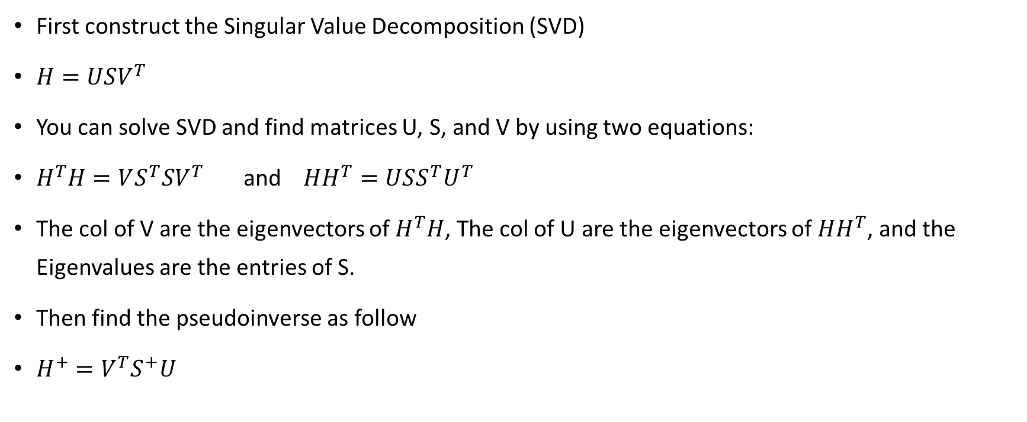
How to compute the pseudoinverse in case matrix H is not invertible i.e. non-square and H not full rank?

Slide 11

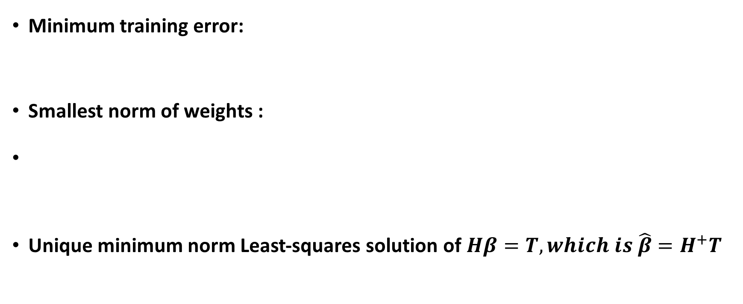
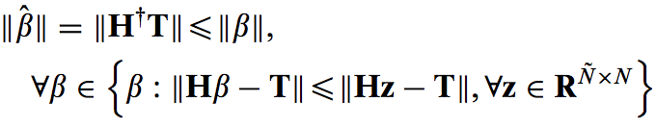

Slide 12
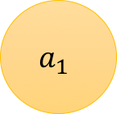
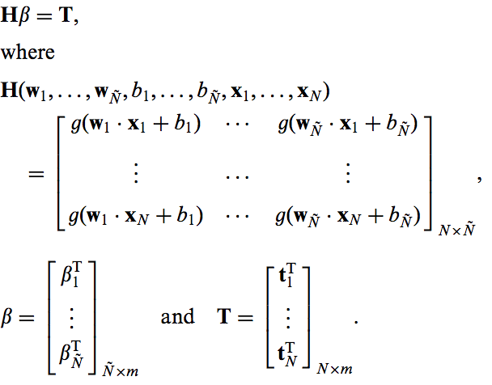
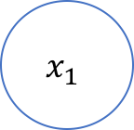
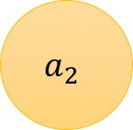
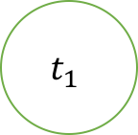
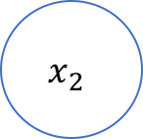
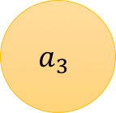
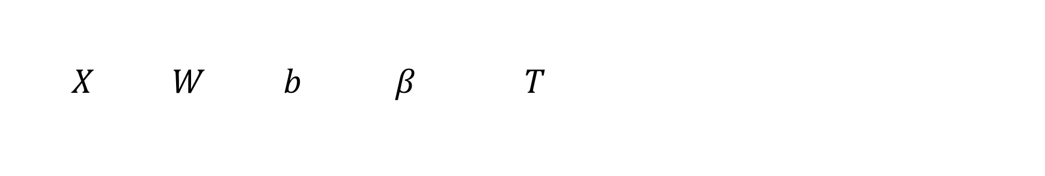
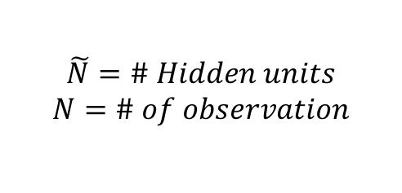
Extreme Learning Machine

Slide 13
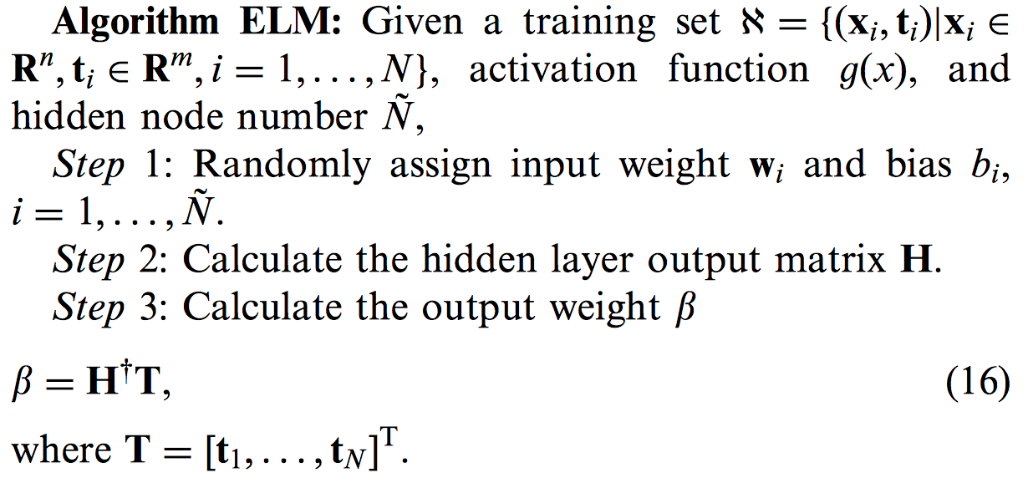
ELM Algorithm

Slide 14
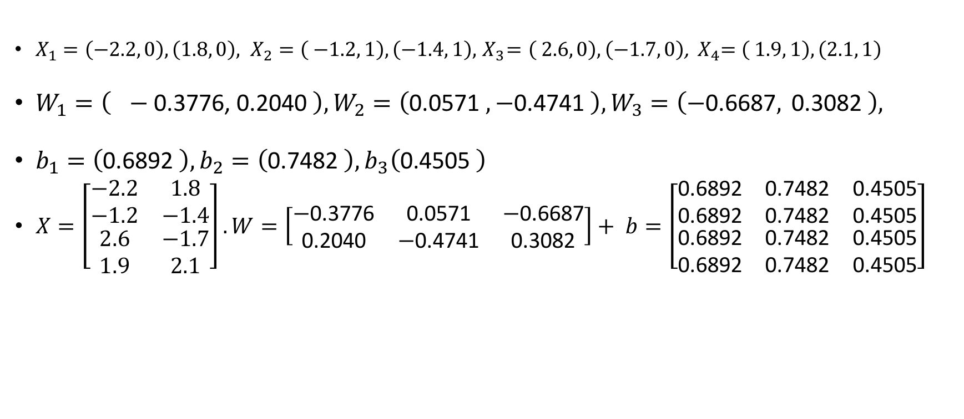
ELM Training Example
2/23/17
CS698 Current Topics in Data Science- Abdulrhman Aljouie Extreme Learning Machine

Slide 15
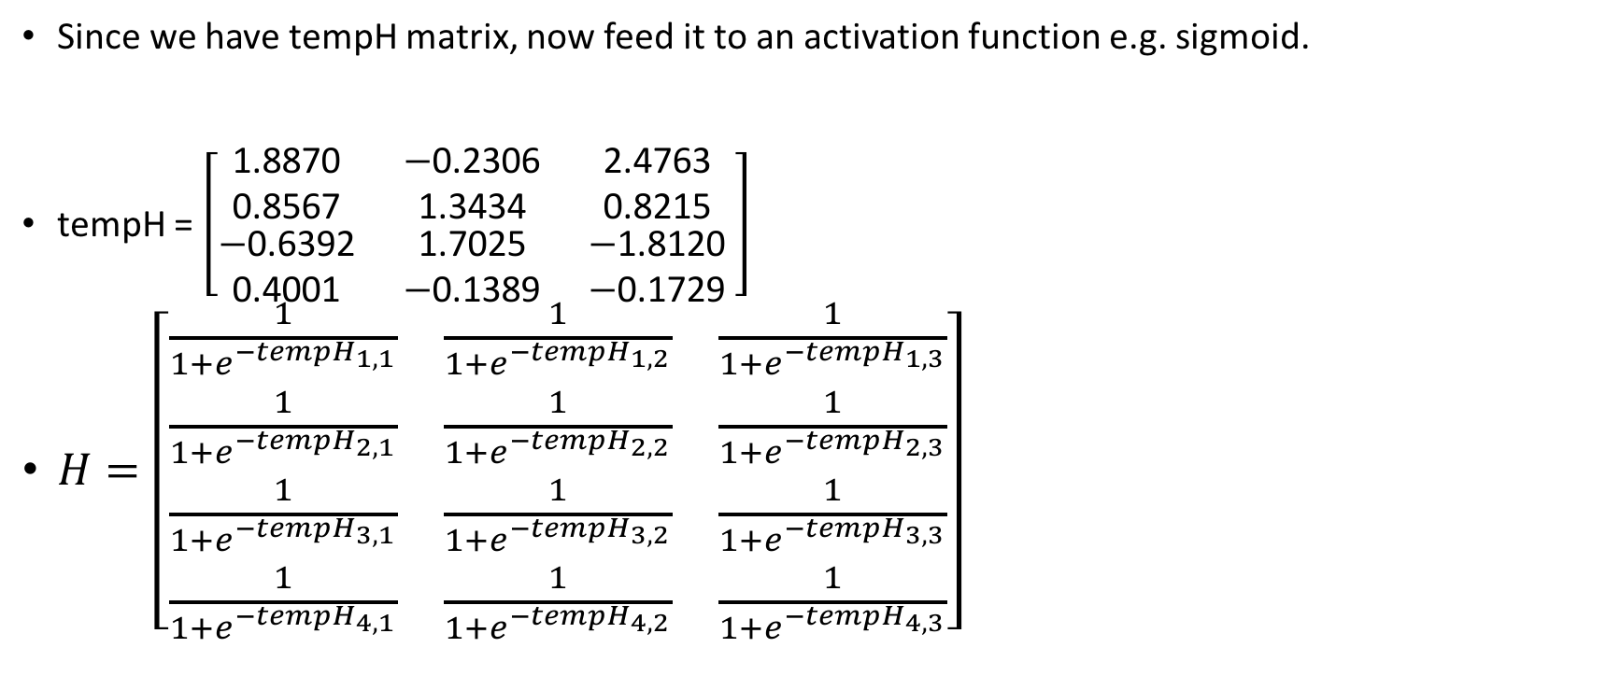
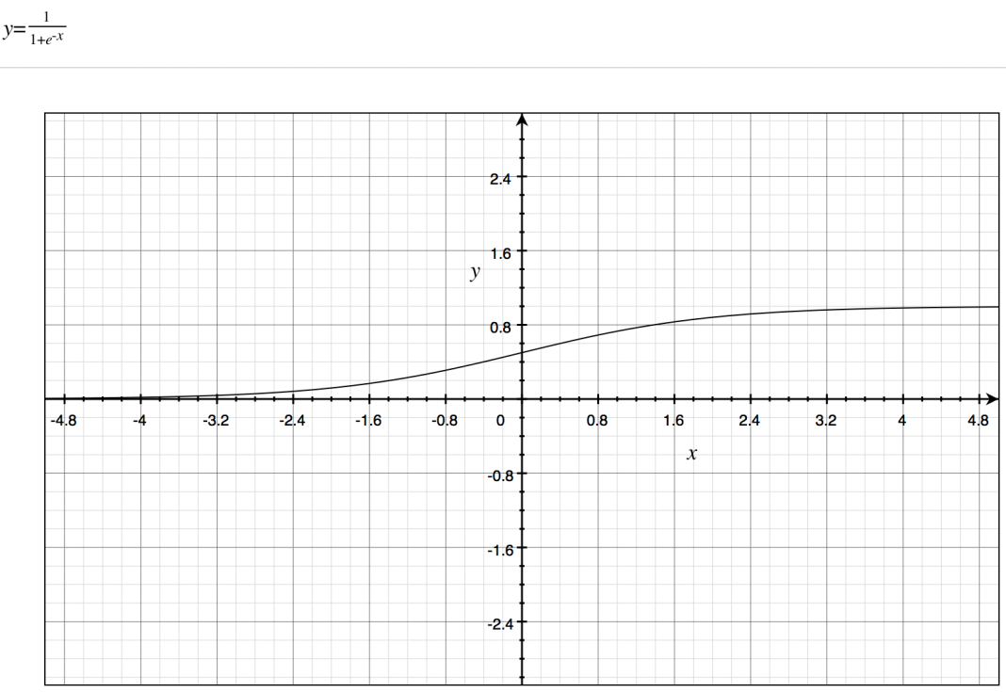
ELM Training Example (continued)
2/23/17
CS698 Current Topics in Data Science- Abdulrhman Aljouie Extreme Learning Machine

Slide 16
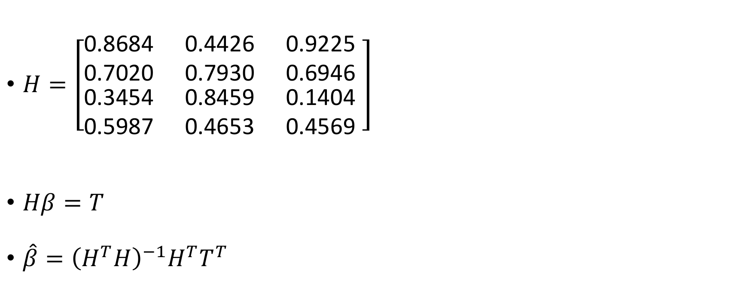
ELM Training Example (continued)
2/23/17
CS698 Current Topics in Data Science- Abdulrhman Aljouie Extreme Learning Machine

Slide 17
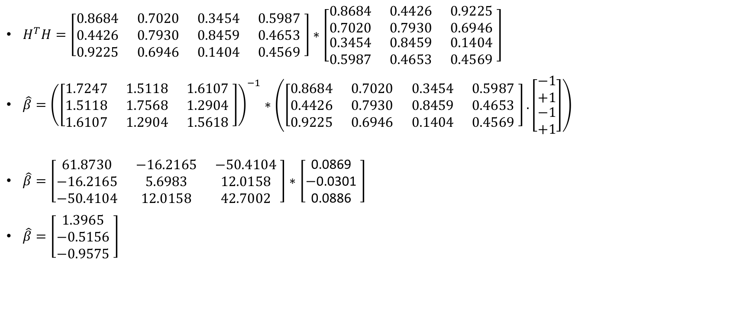
ELM Training Example (continued)
2/23/17
CS698 Current Topics in Data Science- Abdulrhman Aljouie Extreme Learning Machine

Slide 18
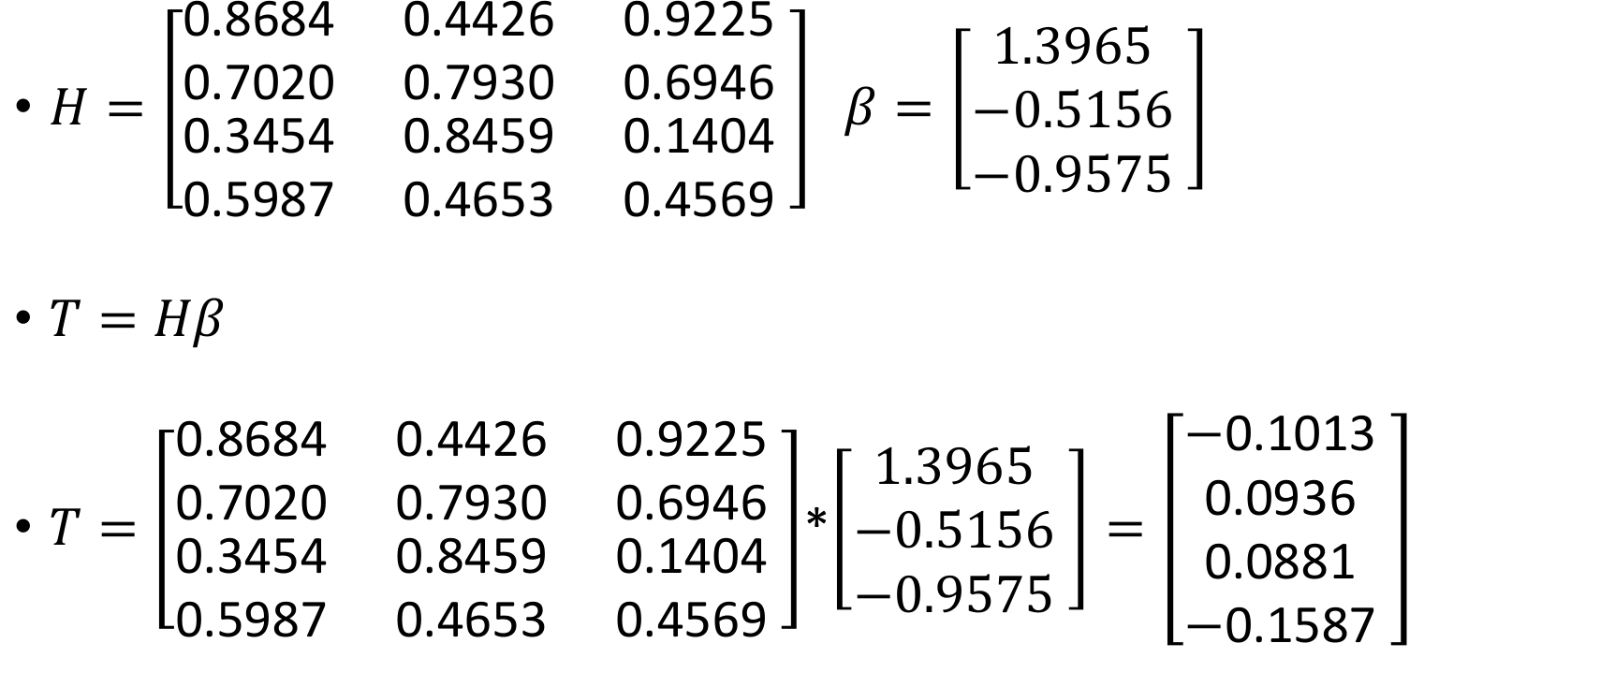
2/23/17
CS698 Current Topics in Data Science- Abdulrhman Aljouie Extreme Learning Machine

Slide 19
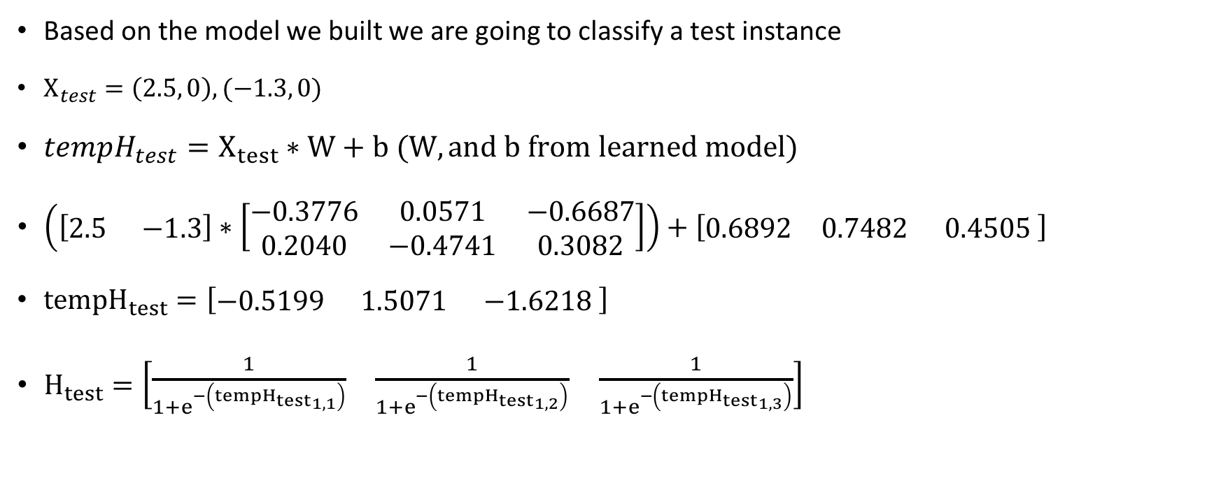
ELM Classify Example
2/23/17
CS698 Current Topics in Data Science- Abdulrhman Aljouie Extreme Learning Machine

Slide 20
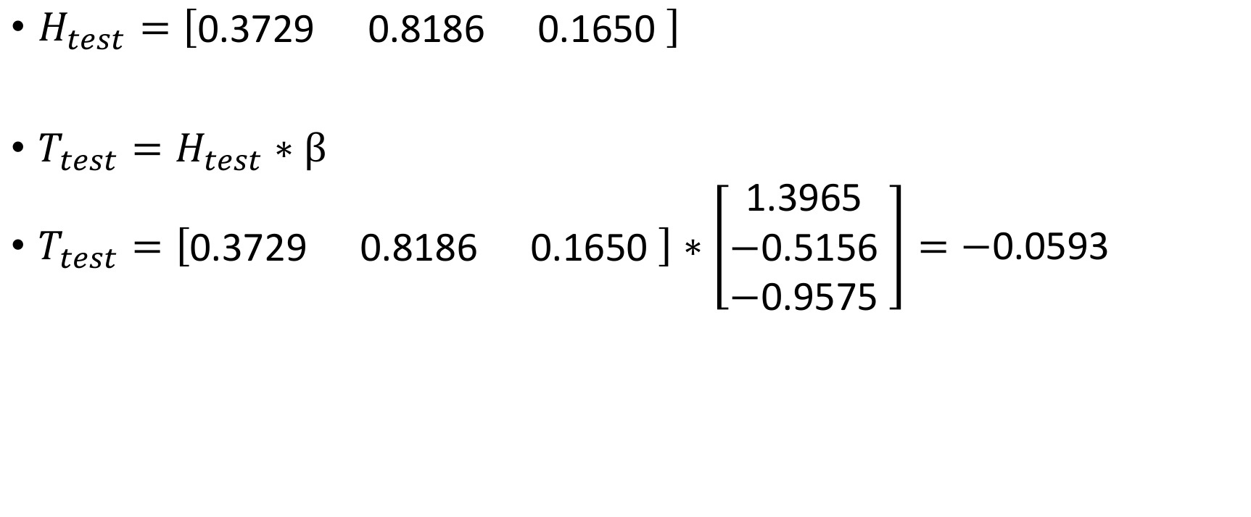
ELM Classify Example
2/23/17
CS698 Current Topics in Data Science- Abdulrhman Aljouie Extreme Learning Machine

Slide 21
ELM have better generalization compared to gradient based algorithm such as BP
Extreme Learning Machine (ELM) | Gradient based Algorithms e.g. Backpropagation
Unique minimum solution | Prone to local minima convergence trap
Reach both smallest training error and smallest weight norm. | Minimizes Error alone.
Does not need a stopping methods. | Overtraining when objective function doesn’t have proper stopping methods and validation.
2/23/17
CS698 Current Topics in Data Science- Abdulrhman Aljouie Extreme Learning Machine

